Slide 1
Recognize Excellence & Development
RED Web Entry Supervisor Training

Slide 2
Objectives of RED web entry
Improve and streamline RED data collection
Develop a tool for supervisors to view RED history
Provide departments with a summary of RED ratings
Collect and store Overall Performance Ratings for Objectives and Competencies
2020 Office of Human Resources

Slide 3
End of cycle process
Request self-assessments from all direct reports
Complete your assessment of all direct reports: Full-Time and Part-Time staff and administrators
Enter ratings into web and wait for approval from your dean or vice president
Meet with each direct report to provide feedback
Employee and Manager electronically sign ratings page of RED
Signed RED form due to the Office of Human Resources by July 31st via email
2020 Office of Human Resources

Slide 4
Login to University Information System (UIS) enter your ID and PIN
https://apollo.stjohns.edu/sjusis/twbkwbis.P_WWWLogin
2020 Office of Human Resources

Slide 5
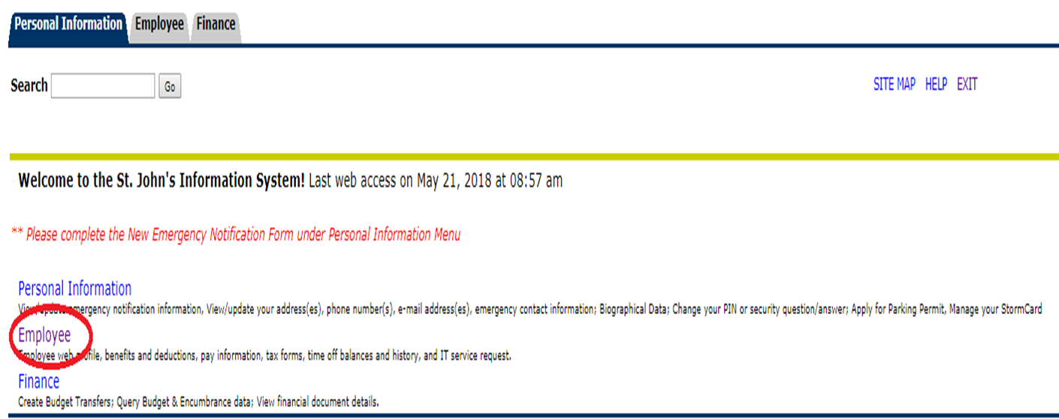
Select Employee Menu
2020 Office of Human Resources

Slide 6
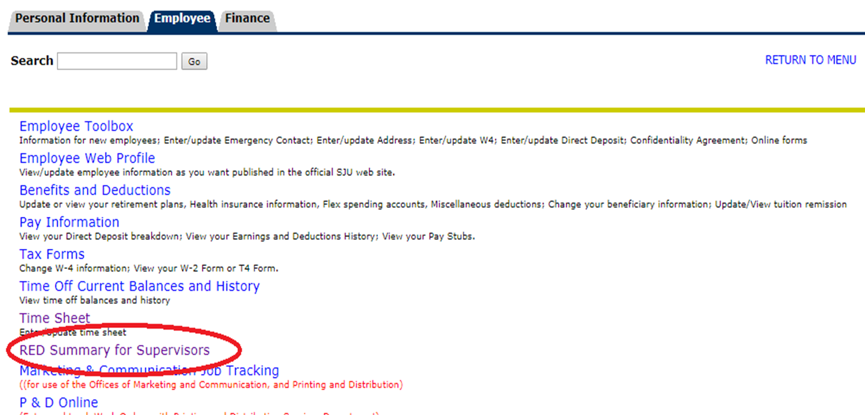
Select RED Summary for Supervisors
2020 Office of Human Resources

Slide 7
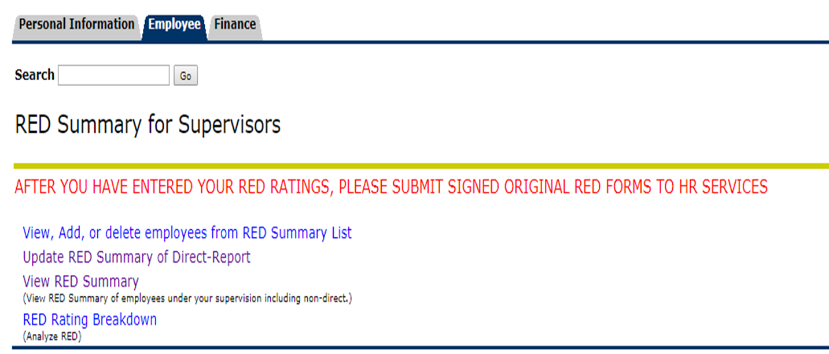
Click on each link below starting with view, add or delete employees
NOTE: 2020 RED Forms will need an electronic signature from the employee and supervisor before submission to HR Services via email.
2020 Office of Human Resources

Slide 8
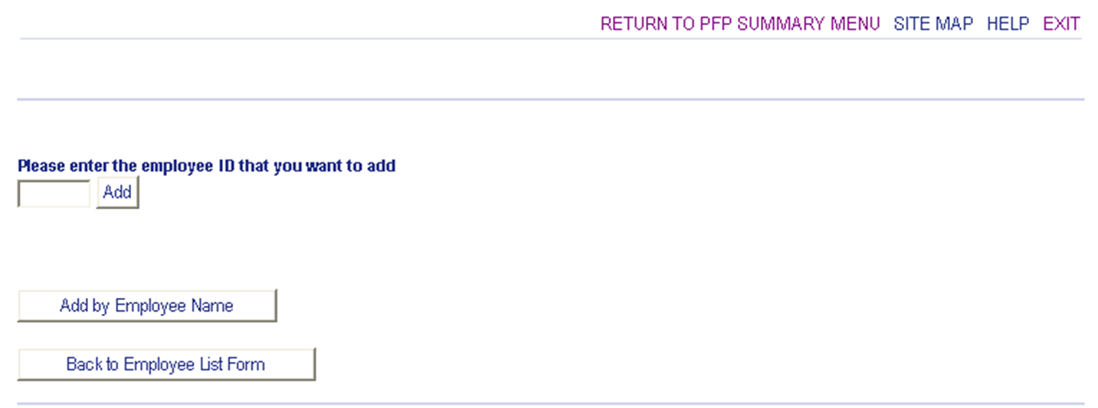
You can add employees to your list by ID (x-number) or search by name. After you Add or Delete all direct reports, you can enter their ratings.
2020 Office of Human Resources

Slide 9
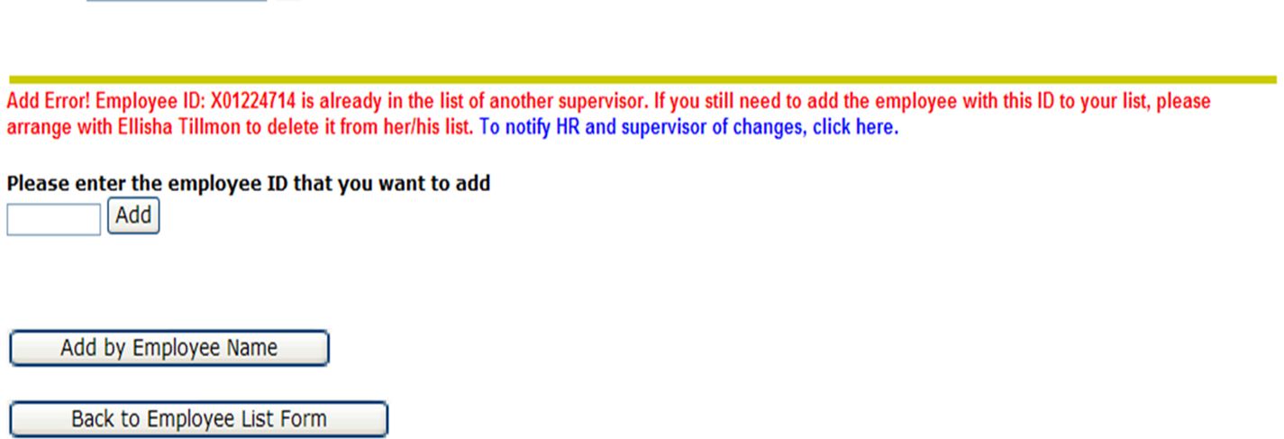
Error message: If employee reports to another supervisor. You can email supervisor and HR. Before you can add employee, previous supervisor must delete from his/her list.
2020 Office of Human Resources

Slide 10
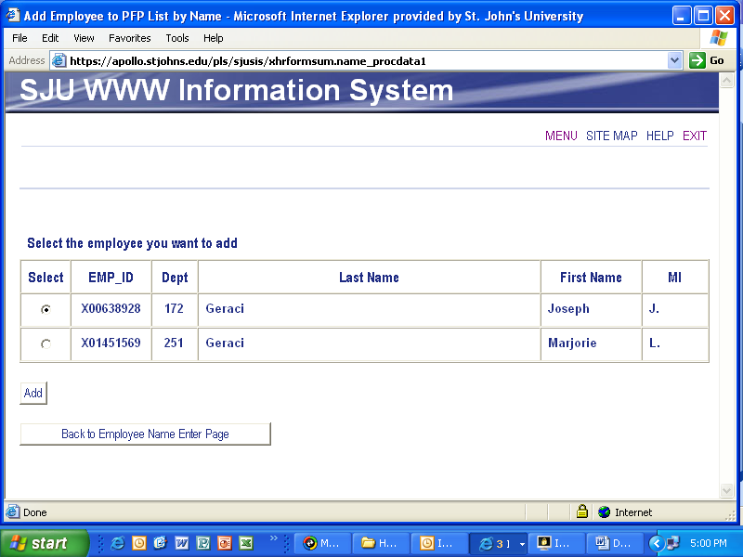
If you search by last name and more than one employee appears, select your direct report from the list and click on the add button
2020 Office of Human Resources

Slide 11
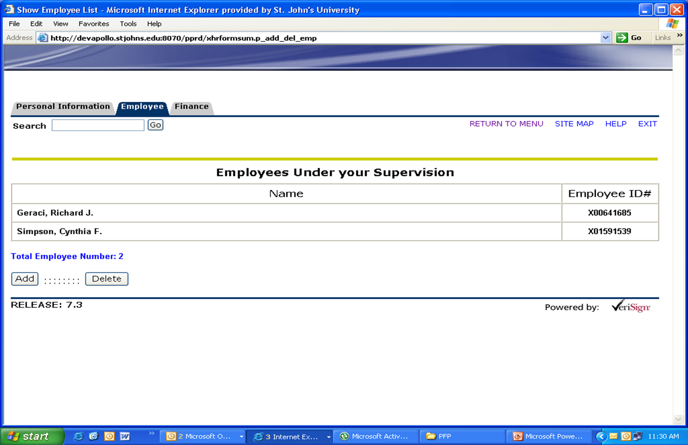
To add or delete an employee, click on the appropriate button
Add or delete names to your direct report list
2020 Office of Human Resources

Slide 12
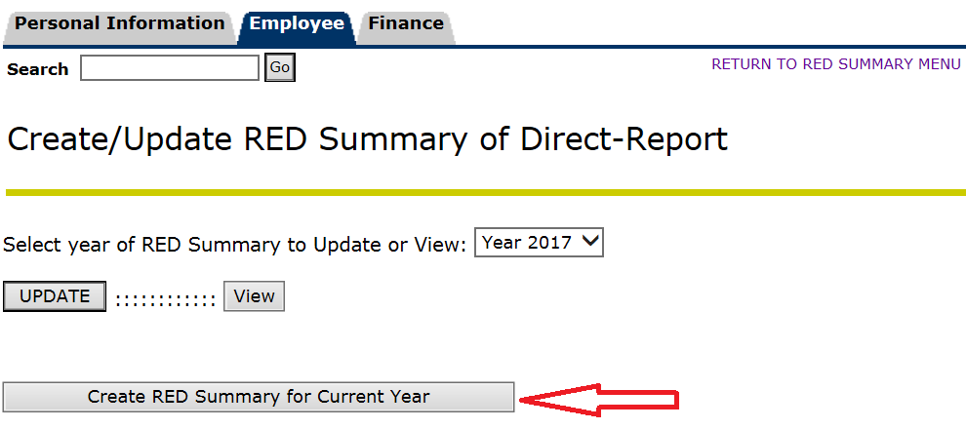
After you review your list of direct reports, return to the RED Summary Menu and click on Update RED Summary. To start new year RED data entry, click on: Create RED Summary for Current Year
2020 Office of Human Resources

Slide 13
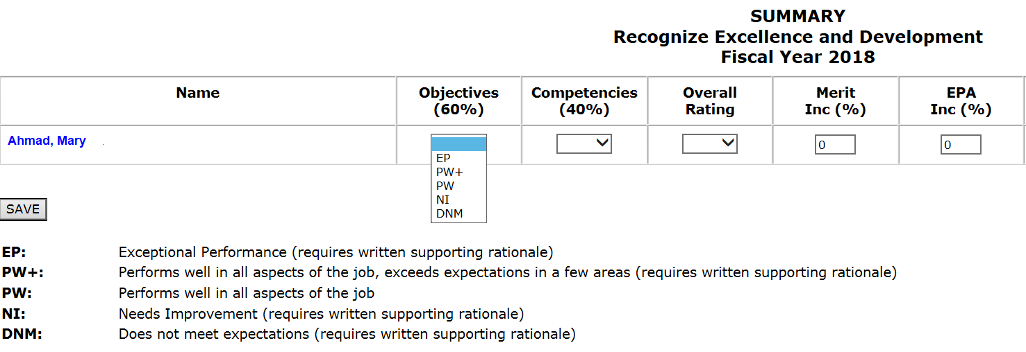
Select from pull-down menu rating for Objectives, Competencies and Overall Rating. You can enter a brief comment that will appear on the final RED Summary page, then SAVE. Click on employee name to view summary page.
2020 Office of Human Resources

Slide 14
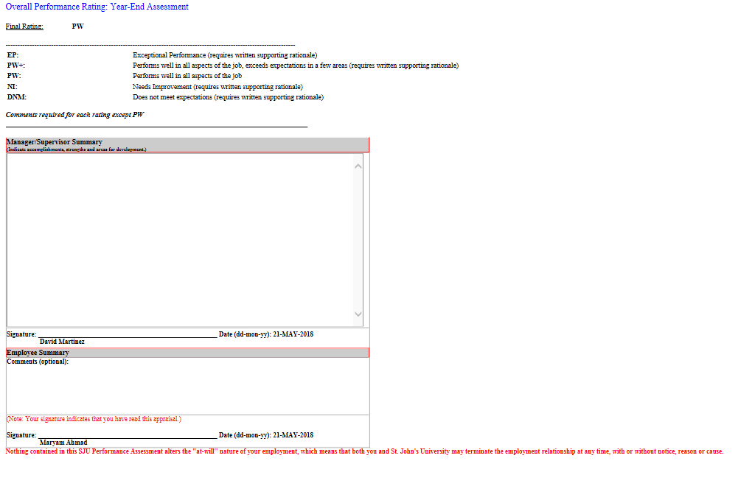
After the final ratings have been entered and approved, you can print the Summary page (ctrl P) and attach to the RED package. Review the final rating with the employee, and both you and employee should sign electronically.
2020 Office of Human Resources

Slide 15
On the Rating Breakdown form, supervisors can view how their direct reports rated employees. The overall summary of department will show percentages. Click on percentages to see employees name.
2020 Office of Human Resources

Slide 16
RED
Enter RED ratings via UIS for all eligible employees including:
Full-time and part-time staff
Full-time and part-time administrators
Long term grant employees
Any employee who began employment before March 31
After ratings have been approved by your dean or vice president, meet with employee for end of cycle performance review discussion
2020 Office of Human Resources

Slide 17
Final Steps
Send all electronically signed original forms, via email, to Human Resources Services by July 31st
Create objectives for the new performance cycle
2020 Office of Human Resources

